Slide 1



Streamlining Mortgage Origination with AI-Powered Verification
Mortgage origination is a complex process involving numerous steps, including income and asset verification. Traditional methods for this process are often manual, time-consuming, and prone to errors. This presentation outlines the potential of AI-powered verification to revolutionize mortgage origination, making it faster, more accurate, and more efficient.
by Joyson Prince Alvares

Slide 2

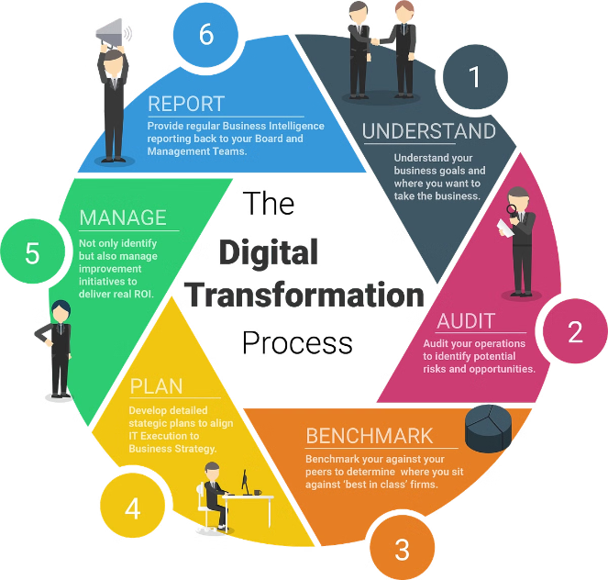
Leveraging AI for Faster, Accurate, and Efficient Mortgage Verification
1
Enhanced Efficiency
AI automates document verification tasks, freeing up mortgage professionals for more complex work, ultimately improving team productivity.
2
Reduced Risk
By minimizing human error through automated verification, AI reduces the risk of inaccuracies and potential financial losses.
3
Improved Customer Experience
Faster verification processes lead to faster loan approvals, ultimately enhancing customer satisfaction and loyalty.
4
Cost Savings
AI-powered verification optimizes resource allocation, reducing the need for extensive manual labour and saving costs.

Slide 3
The Current Process and Its Challenges
Traditional Approach
Human Error
The Need for Change
Manual verification involves gathering and reviewing documents, requiring significant time and effort. This can create delays in the loan processing timeline.
Manual verification is vulnerable to human error, which can lead to inaccuracies in data validation, potentially delaying loan approvals or resulting in financial consequences.
The current process is cumbersome and inefficient. Implementing AI-powered verification is critical for streamlining the mortgage origination process and addressing these challenges.

Slide 4


Transforming Mortgage Origination with AI
1
Document Extraction
AI automatically extracts key data points from documents like bank statements and pay slips, reducing manual data entry and errors.
2
Data Validation
AI cross-references and validates extracted data against third-party sources in real-time, ensuring accuracy and minimizing discrepancies.
3
Decision Support
AI provides data-driven insights to mortgage professionals, empowering them to make faster and more informed decisions regarding loan approvals.

Slide 5


Embrace the Future of Mortgage Origination
Enhanced Competitiveness
By implementing AI-powered verification, mortgage lenders can provide a faster and more efficient experience, differentiating themselves from competitors.
Improved Customer Experience
AI-powered verification streamlines the loan approval process, resulting in faster processing times and higher customer satisfaction.
Future-Proofing Operations
Embracing AI technology positions mortgage lenders for future success, allowing them to adapt to changing market demands and maintain operational efficiency.

Slide 6

Thank You
We appreciate your partnership and look forward to continued success together.

